Slide 1
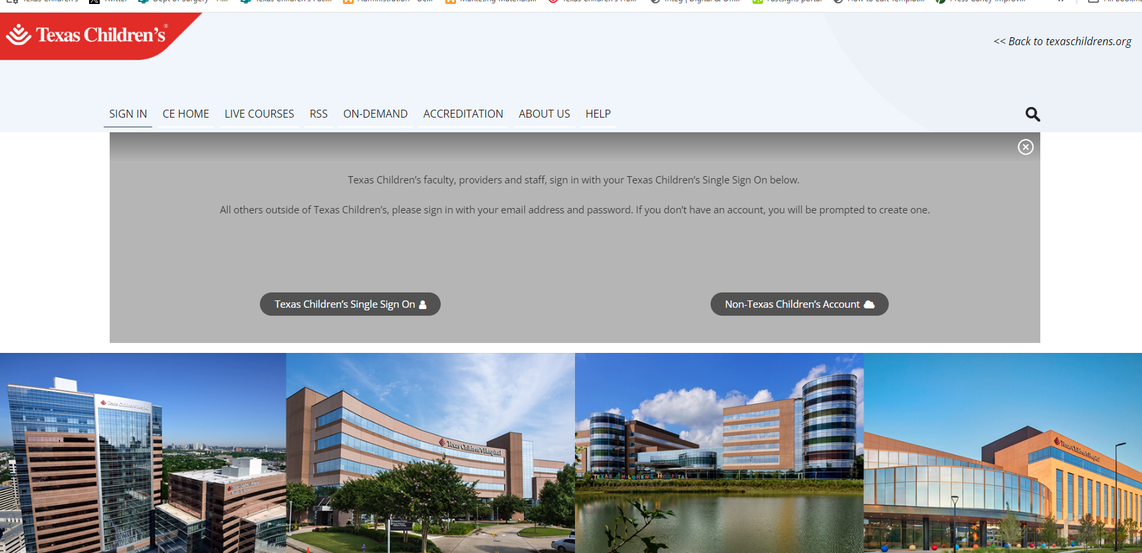
https://tc.cloud-cme.com
A. Setting up your CloudCME Account (TCH Users)
1
Use a desktop/laptop for the best experience
2
3

Slide 2
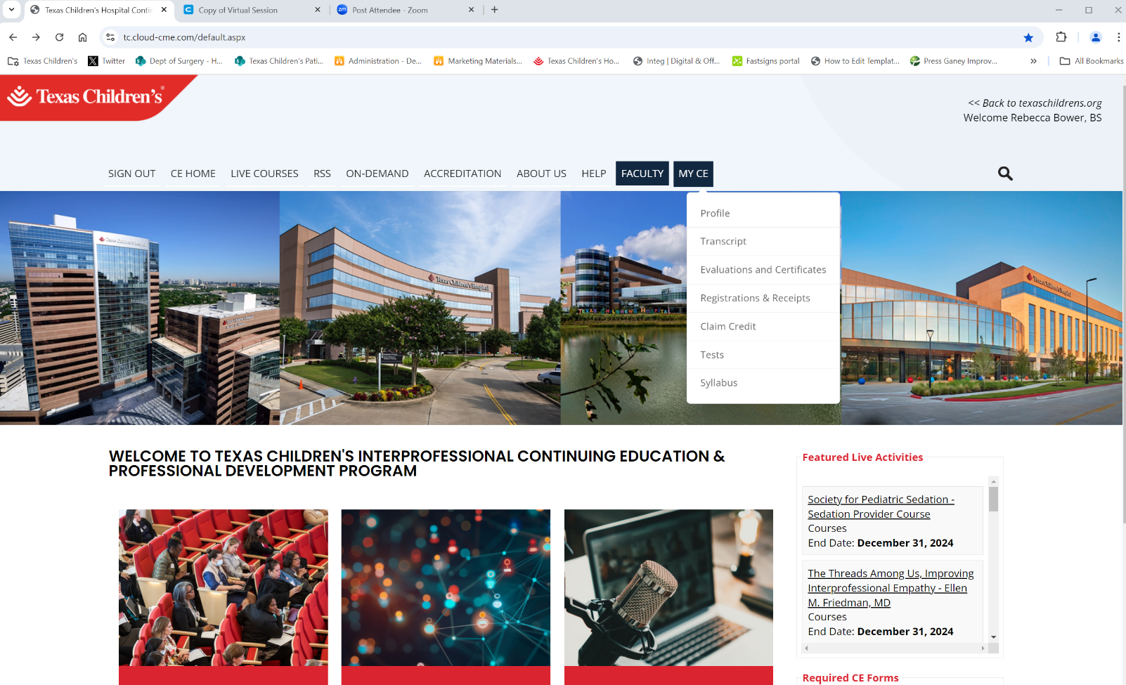
A. Complete your Profile
Have these
numbers ready:
NPI Number
Board Numbers
TMB License
4
5
Make sure the appropriate “profession” is checked.
Enter cell phone in both Phone and Mobile in this format
###-###-####
Must use hyphens

Slide 3
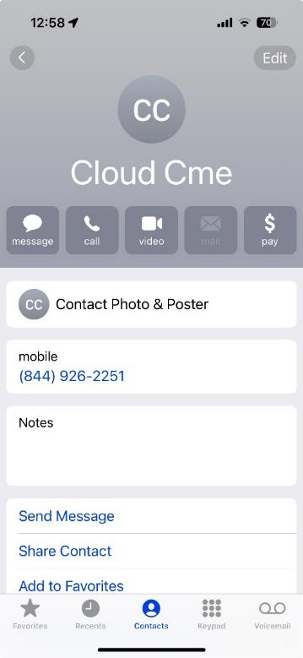
B. Add CloudCME to your cell phone contacts
844-926-2251
Allows you to text your attendance using the activity ID code
*****Your cell phone number must be linked in your profile

Slide 4
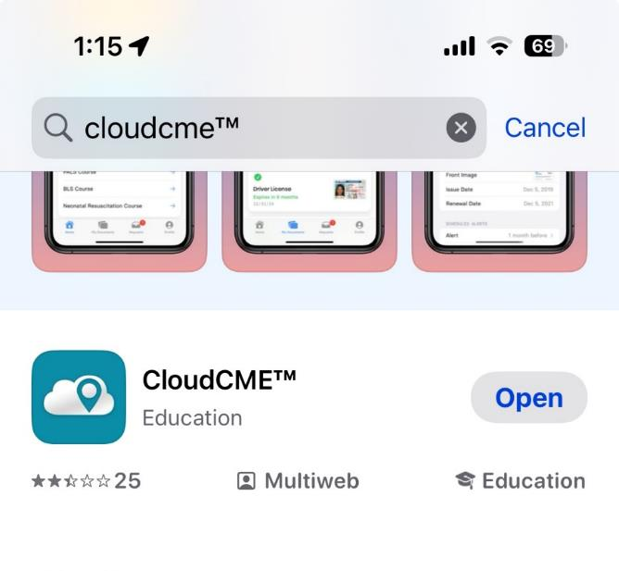
C. Download the CloudCME App
Search for CloudCME in your app store
Log in using your TCH single sign on
Organization Code is TC

